Slide 1
Customer Profile Aalysis

Slide 2
About the data set
Was based on 2014-2017 consumption data from utilities companies training datasets
Tracks real energy utilities application, usage, and online/mobile applications data from cities that have been renamed to futuristic Hellenic cities, while the user data have been altered and anonymized.

Slide 3
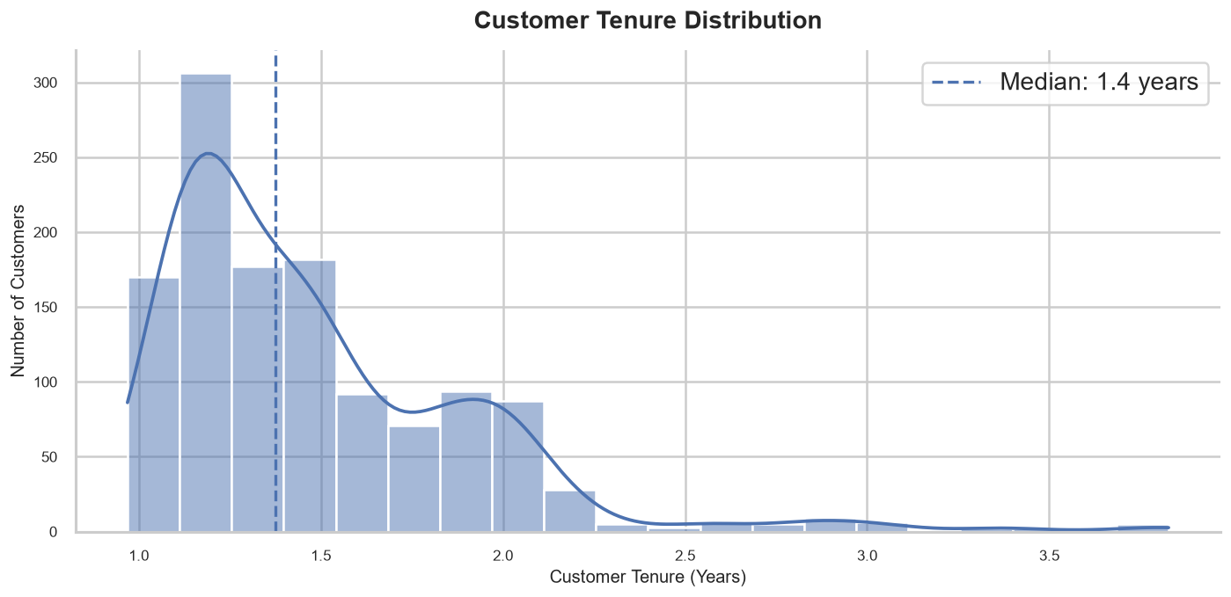
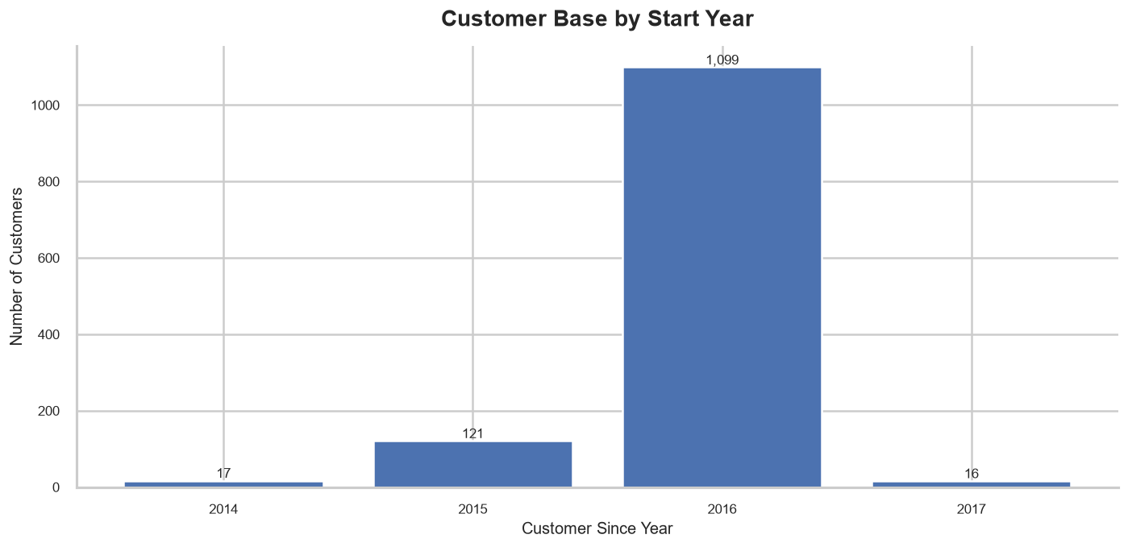
Customer Profile
Median customer tenure is just 1.4 years — a relatively young customer base
2016 was a breakout growth year, adding more than 1,000 new customers
Growth has since stalled sharply (only 16 new customers in 2017)

Slide 4
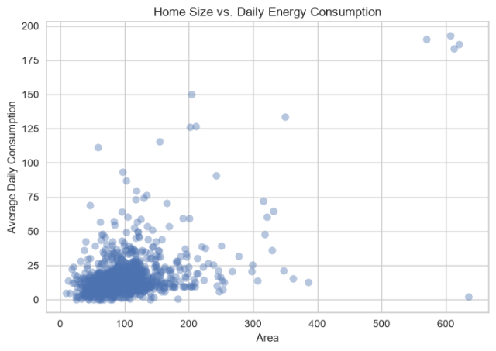
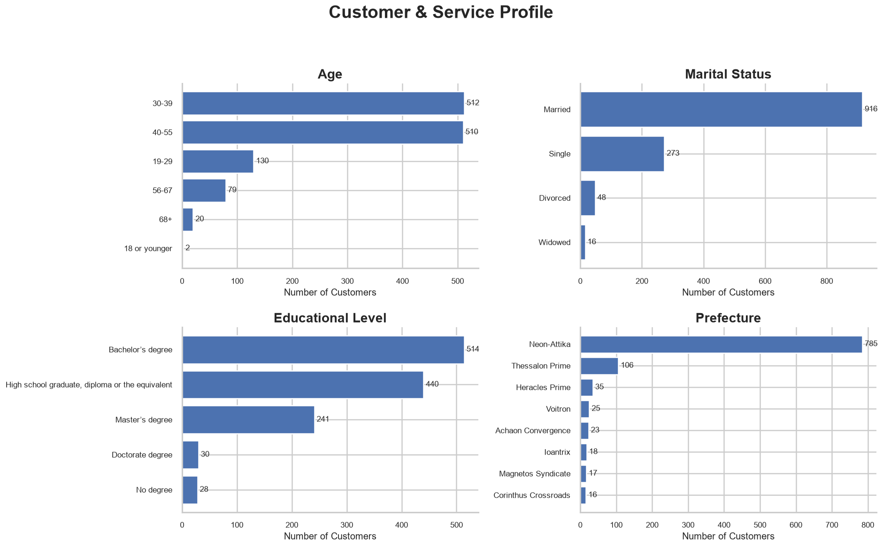
Customer Profile
Core customer base is prime working-age
Married customers represent the largest customer segment
The customer base is well-educated, with 60% holding a Bachelor's degree or higher
Larger homes consume more, as expected
Majority of customers cluster in homes under 200 m² with consumption under 50 units/day
A handful of outliers (500+ m²) - potential targets for efficiency programs

Slide 5
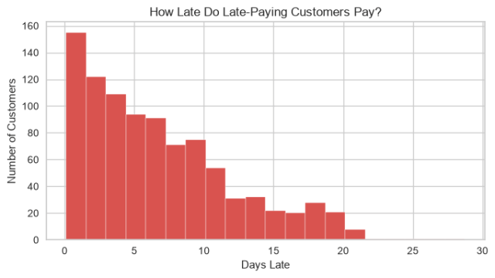
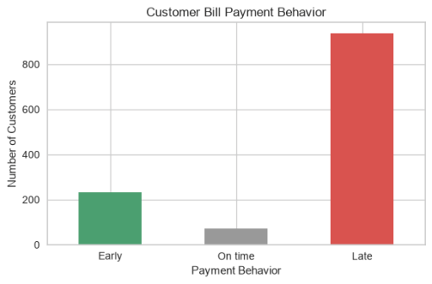
Customer Behavior
73% of customers pay late—cash-flow risk
Only 6% pay on time; the rest pay early
Among late payers, most are only slightly late (1–5 days),

Slide 6
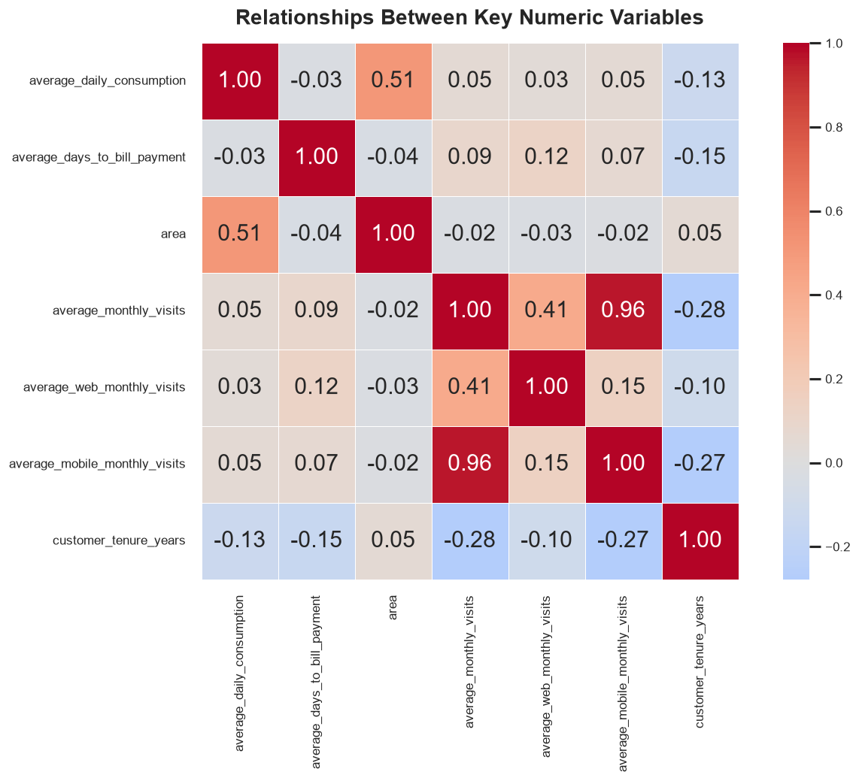
Key Correlations
Area ↔ Consumption (0.51): the only strong "real" driver relationship — larger homes use more energy
Monthly Visits = Web + Mobile Visits (0.96 mobile, 0.41 web) — visits are dominated by mobile channel, confirming mobile as the primary engagement touchpoint
Web vs. Mobile usage are largely independent (0.15)
Longer-tenured customers visit less
Bill payment timing shows no meaningful correlation with consumption, area, or engagement

Slide 7
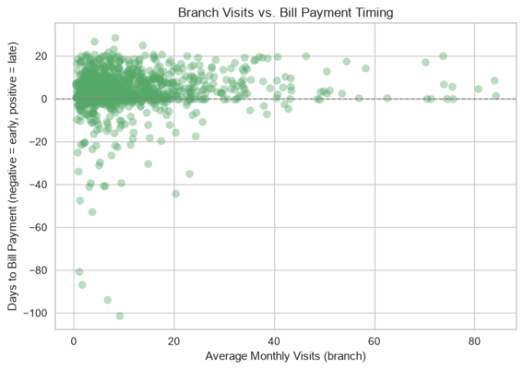
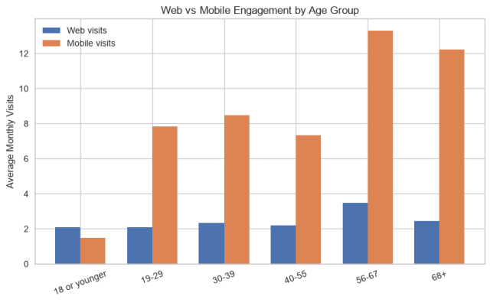
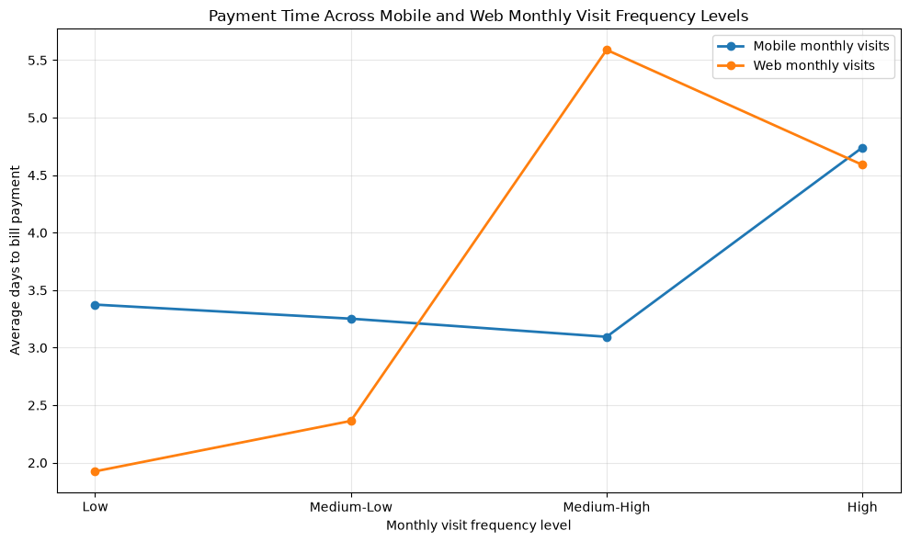
What is the relationship between mobile/web engagement and customers’ payment turnaround time?
Mobile: Payment time decreases with higher visit frequency up to a moderate high level, but increases among the high frequency visitors.
Web: Higher monthly visit frequency is generally associated with longer payment times.
Key takeaway: High visit frequency does not necessarily indicate faster payment and may signal customers who require more interaction before completing payment

Slide 8
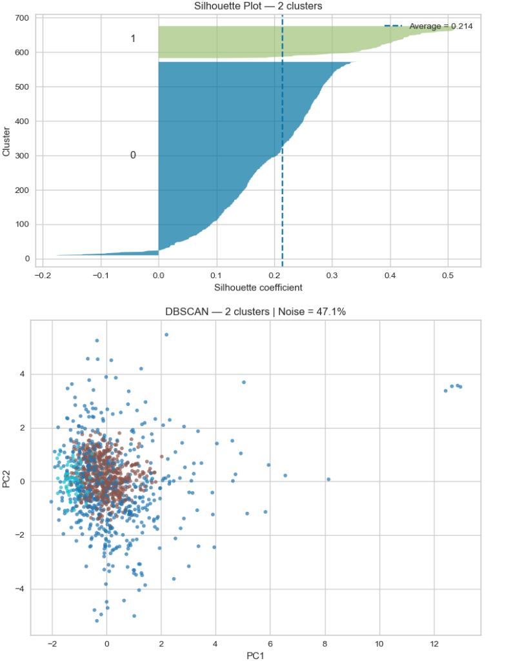
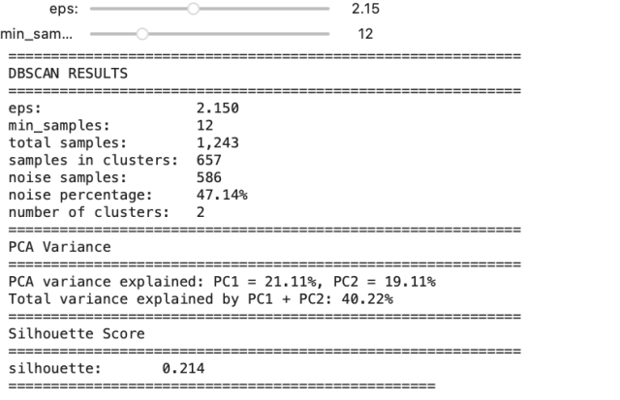
Choosing the Right Model: DBSCAN

Slide 9
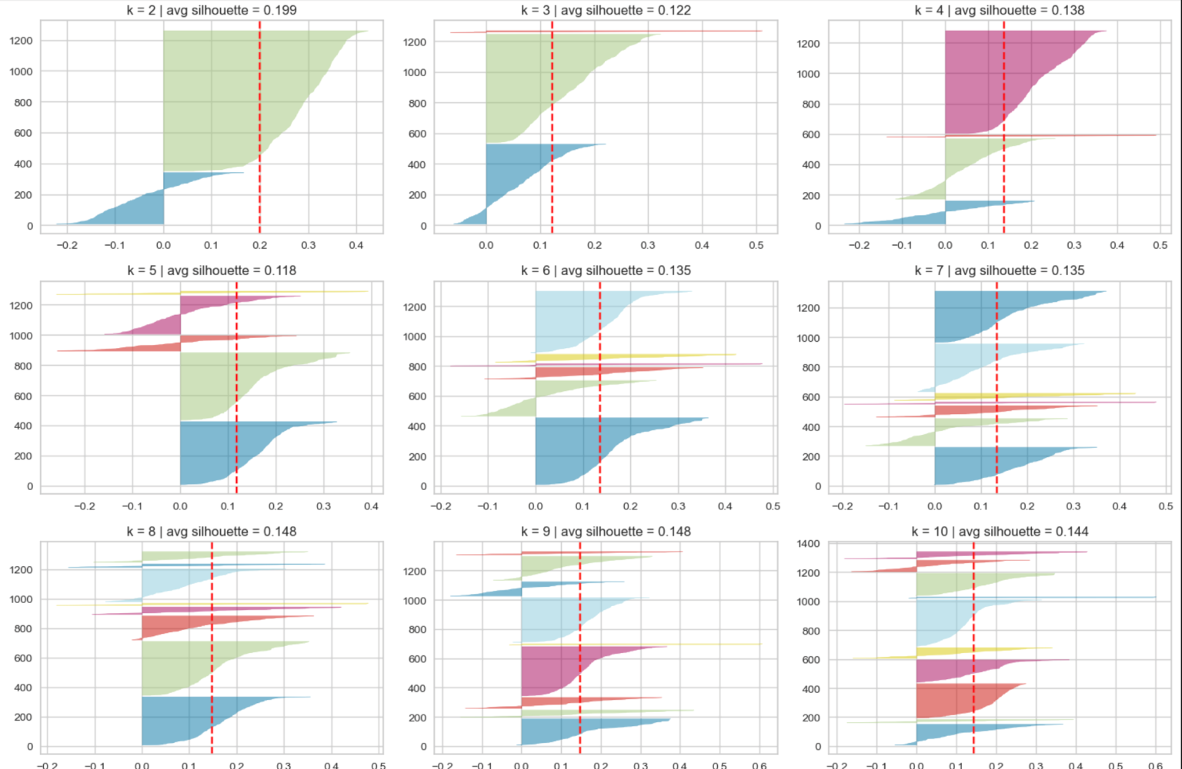
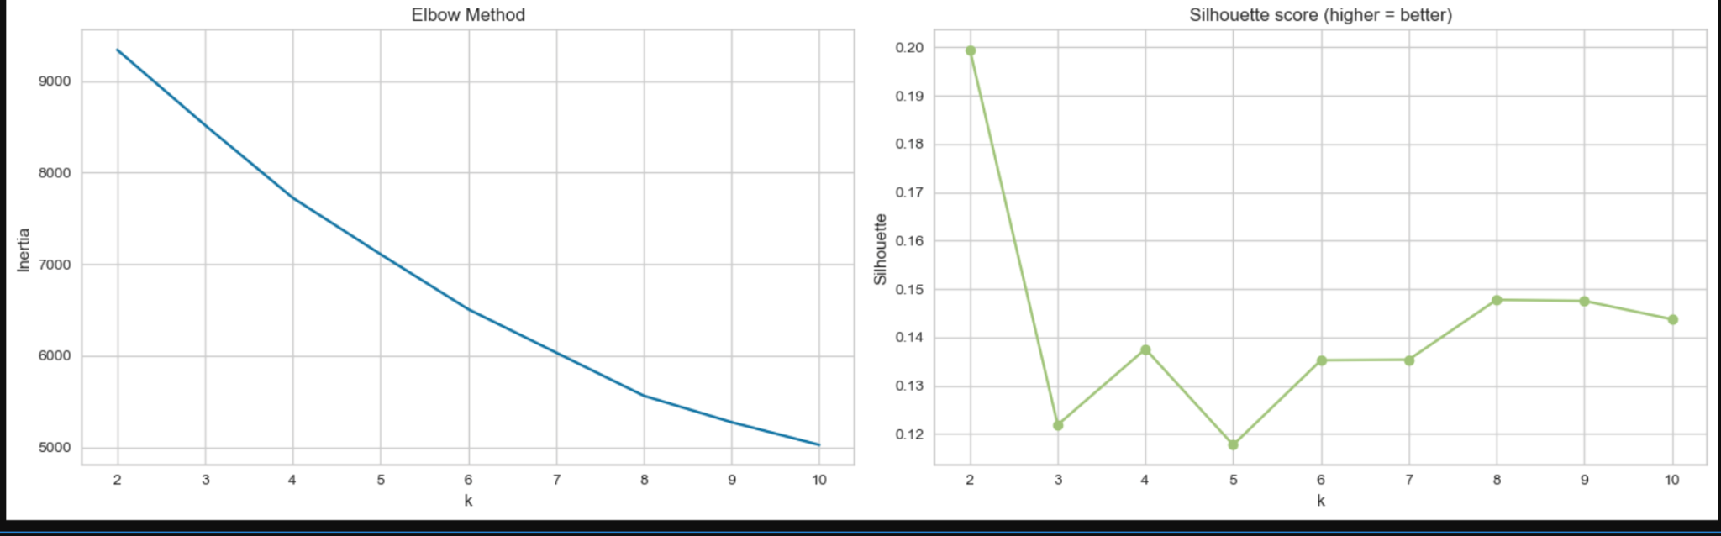
Choosing the Right Model:
K-Means

Slide 10
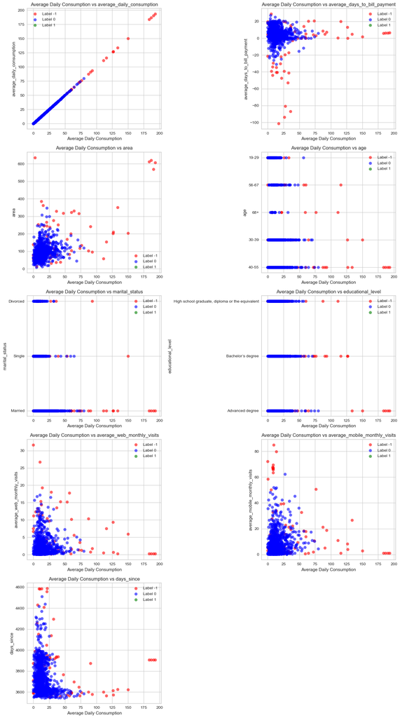
Results: Profile Clustering

Slide 11
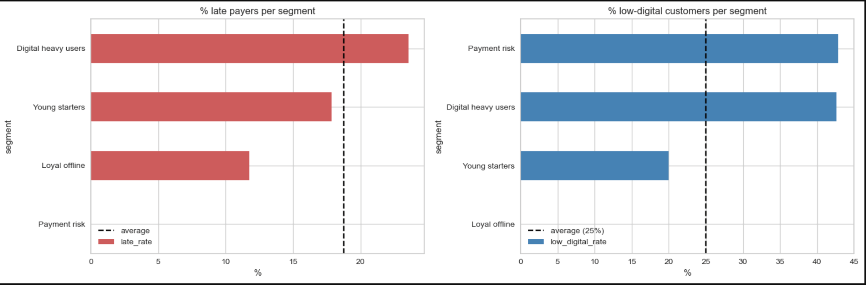
Results: Profile Clustering

Slide 12
Q&A

Slide 13
Thanks for your attention!

